Slide 1


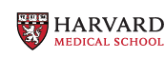
Machine Learning Tools in Computational Neuroimaging: From Connectomes to FIT
Machine Learning for Health
Dr. Mahnaz Maddah
Javid Dadashkarimi, PhD
Postdoctoral Fellow MGH/Harvard

Slide 2
Outline
Functional Connectomes
Tool 1: Data-driven Methods with Optimal Transport
Fetus, Infant, and Toddler (FIT) Neuroimaging
Tool 2: Automated Fetal Brain Extraction
Final Remarks

Slide 3
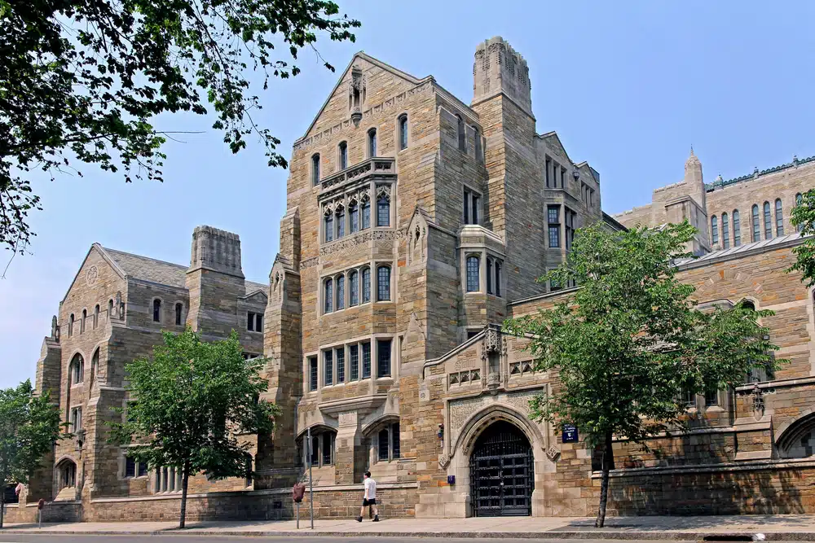



Predoctoral Training
I graduated in 2023, Computer Science, Yale University

Slide 4
Outline
Functional Connectomes
Tool 1: Data-driven Methods with Optimal Transport
Fetus, Infant, and Toddler (FIT) Neuroimaging
Tool 2: Automated Fetal Brain Extraction
Final Remarks

Slide 5
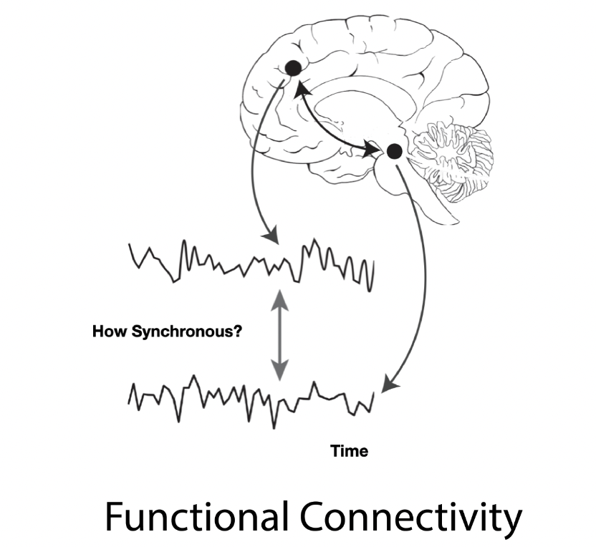
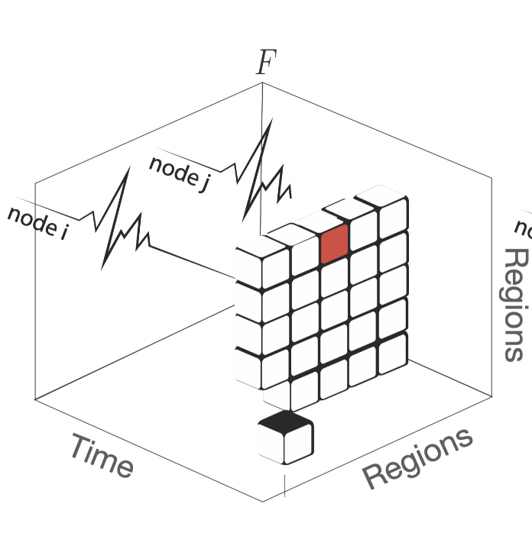
Functional Connectomes

Slide 6
Functional Connectomes
Understanding functional organization of the brain
Explanatory analysis
Predictive modeling

Slide 7
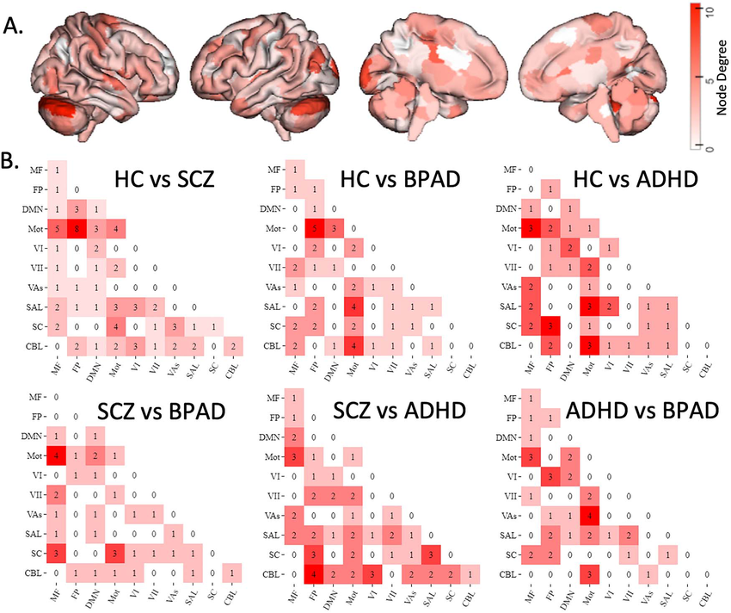
Explanatory Analysis
T-test is designed for one variable.
If we have multiple connectomes, we need advanced tools.
Barron, Daniel S. – Dadashkarimi, Javid -- et al. "Transdiagnostic, connectome-based prediction of memory constructs across psychiatric disorders." Cerebral Cortex 31.5 (2021): 2523-2533. APA

Slide 8
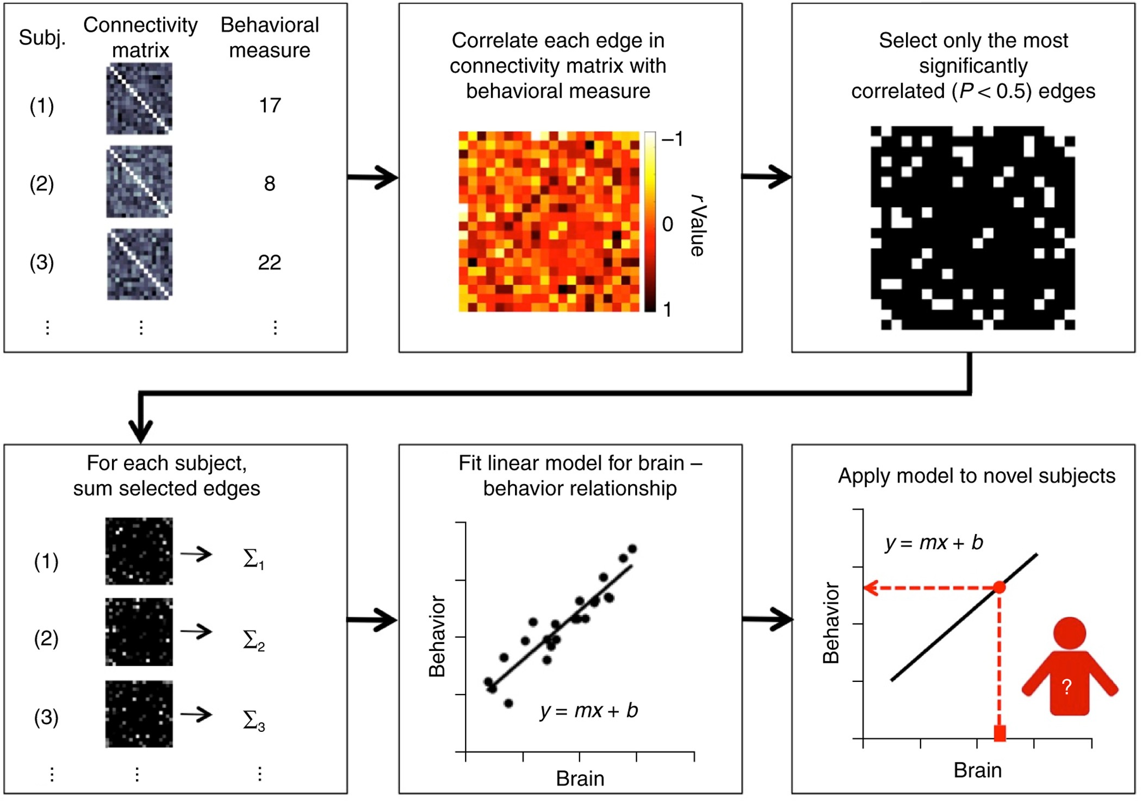
Predictive Models
Predictive models reveal the brain's functional organization.
More data enhances predictive power.
Shen, Xilin, et al. "Using connectome-based predictive modeling to predict individual behavior from brain connectivity." Nature Protocols 12.3 (2017): 506-518.

Slide 9
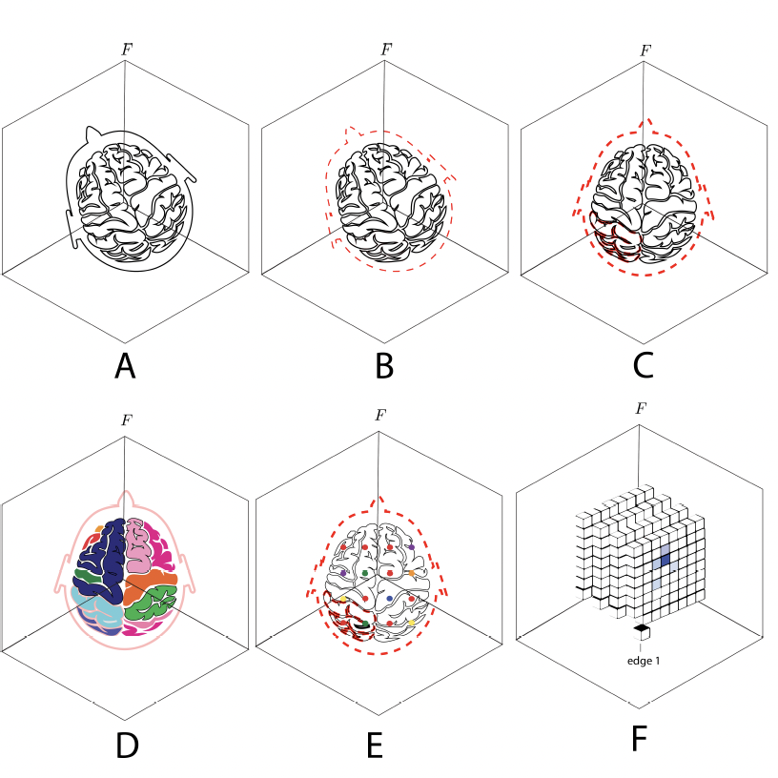
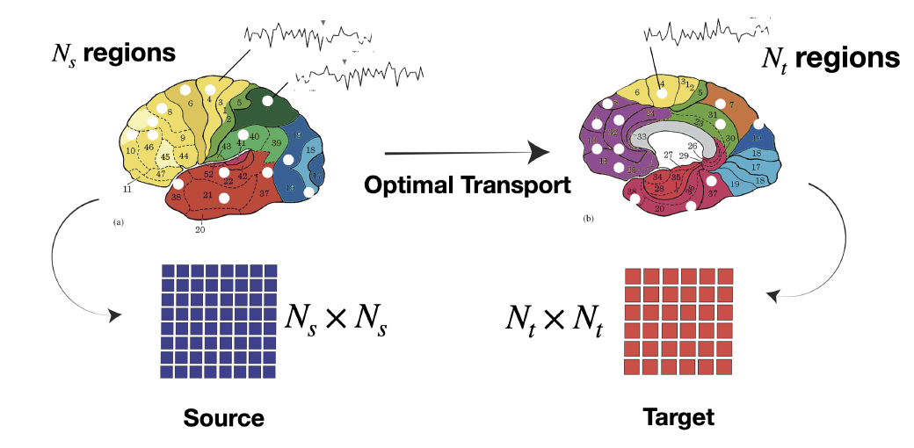
Data Sharing and The Atlas Problem
Connectomes derived from one atlas, are not directly comparable to those from a different atlas

Slide 10
Outline
Functional Connectomes
Tool 1: Data-driven Methods with Optimal Transport
Fetus, Infant, and Toddler (FIT) Neuroimaging
Tool 2: Automated Fetal Brain Extraction
Final Remarks

Slide 11
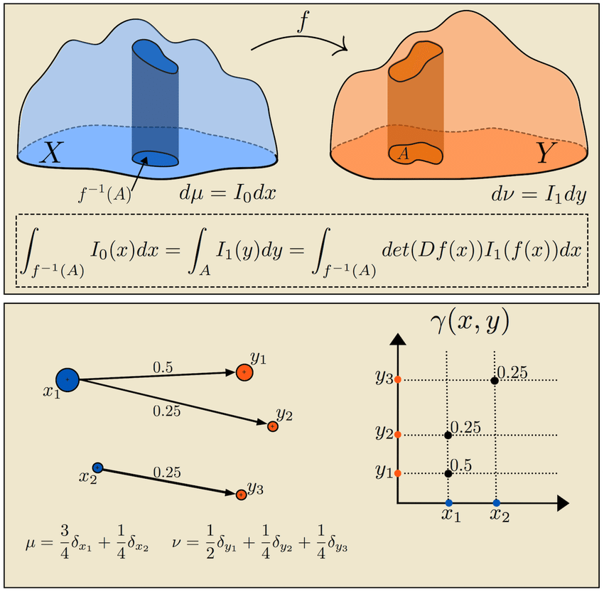
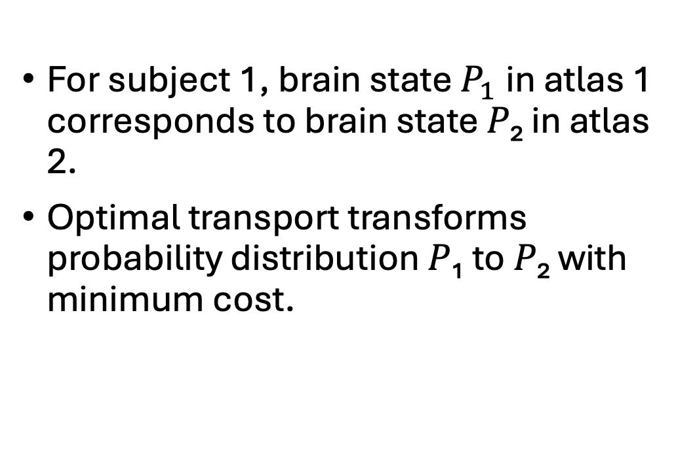
Tool 1: Cross Atlas Remapping via Optimal Transport (CAROT)
For subject 1, brain state$P_{1}$in atlas 1 corresponds to brain state 𝑃₂ in atlas 2.
Optimal transport transforms probability distribution 𝑃₁ to 𝑃₂ with minimum cost.
Peyré, Gabriel, and Marco Cuturi. "Computational optimal transport: With applications to data science." Foundations and Trends® in Machine Learning 11.5-6 (2019): 355-607.

Slide 13
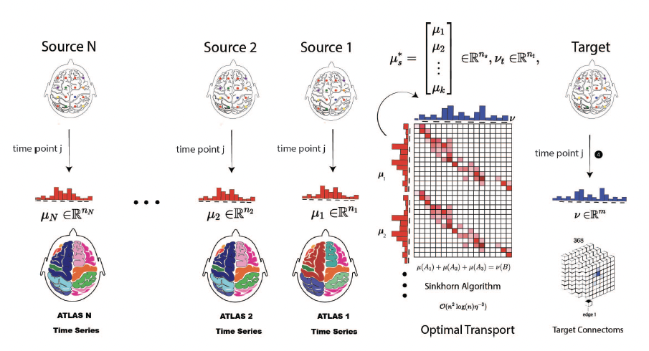
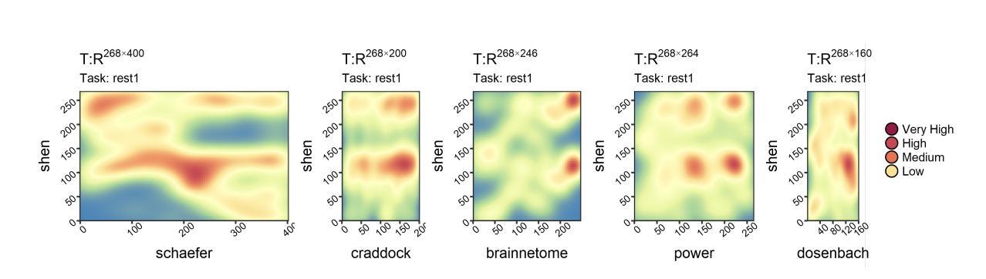
Tool 1: Cross Atlas Remapping via Optimal Transport (CAROT)
Pre-trained Transportation Policies

Slide 14
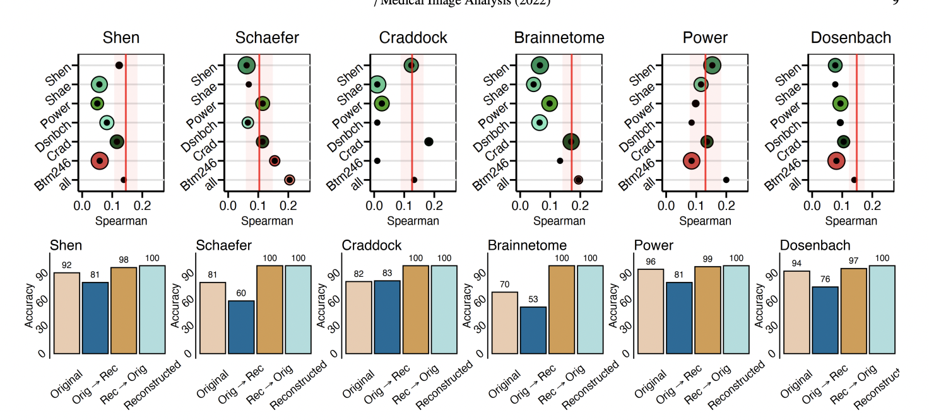
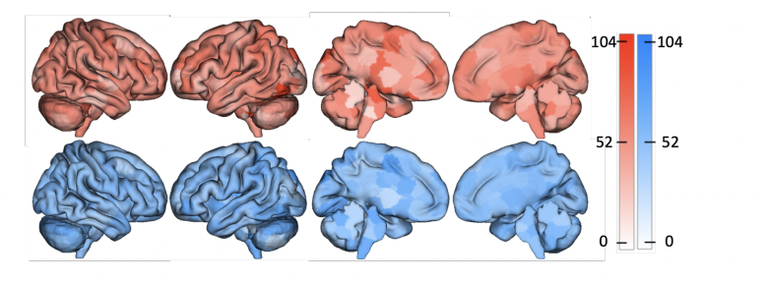
Tool 1: Cross Atlas Remapping via Optimal Transport (CAROT)
Fluid Intelligence Prediction
original
Reconstructed
Fingerprinting
Dadashkarimi, Javid, et al. "Cross Atlas Remapping via Optimal Transport (CAROT): Creating connectomes for different atlases when raw data is not available." Medical image analysis 88 (2023).
Liang, Qinghao, Dadashkarimi, Javid, et al. "Transforming Connectomes to “Any” Parcellation via Graph Matching." MICCAI Workshop on Imaging Systems for GI Endoscopy. (Best Paper Award).

Slide 15
Outline
Functional Connectomes
Tool 1: Data-driven Methods with Optimal Transport
Fetus, Infant, and Toddler (FIT) Neuroimaging
Tool 2: Automated Fetal Brain Extraction
Final Remarks

Slide 16
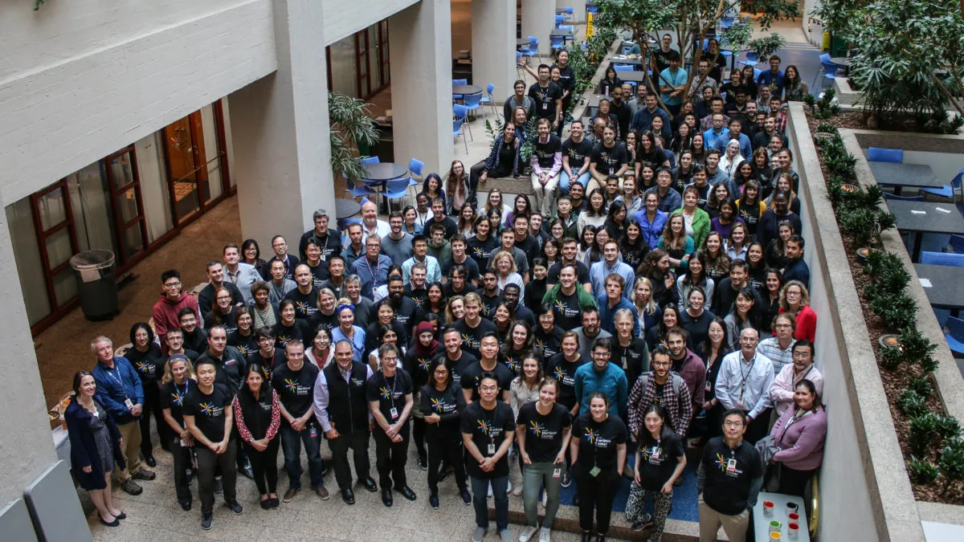
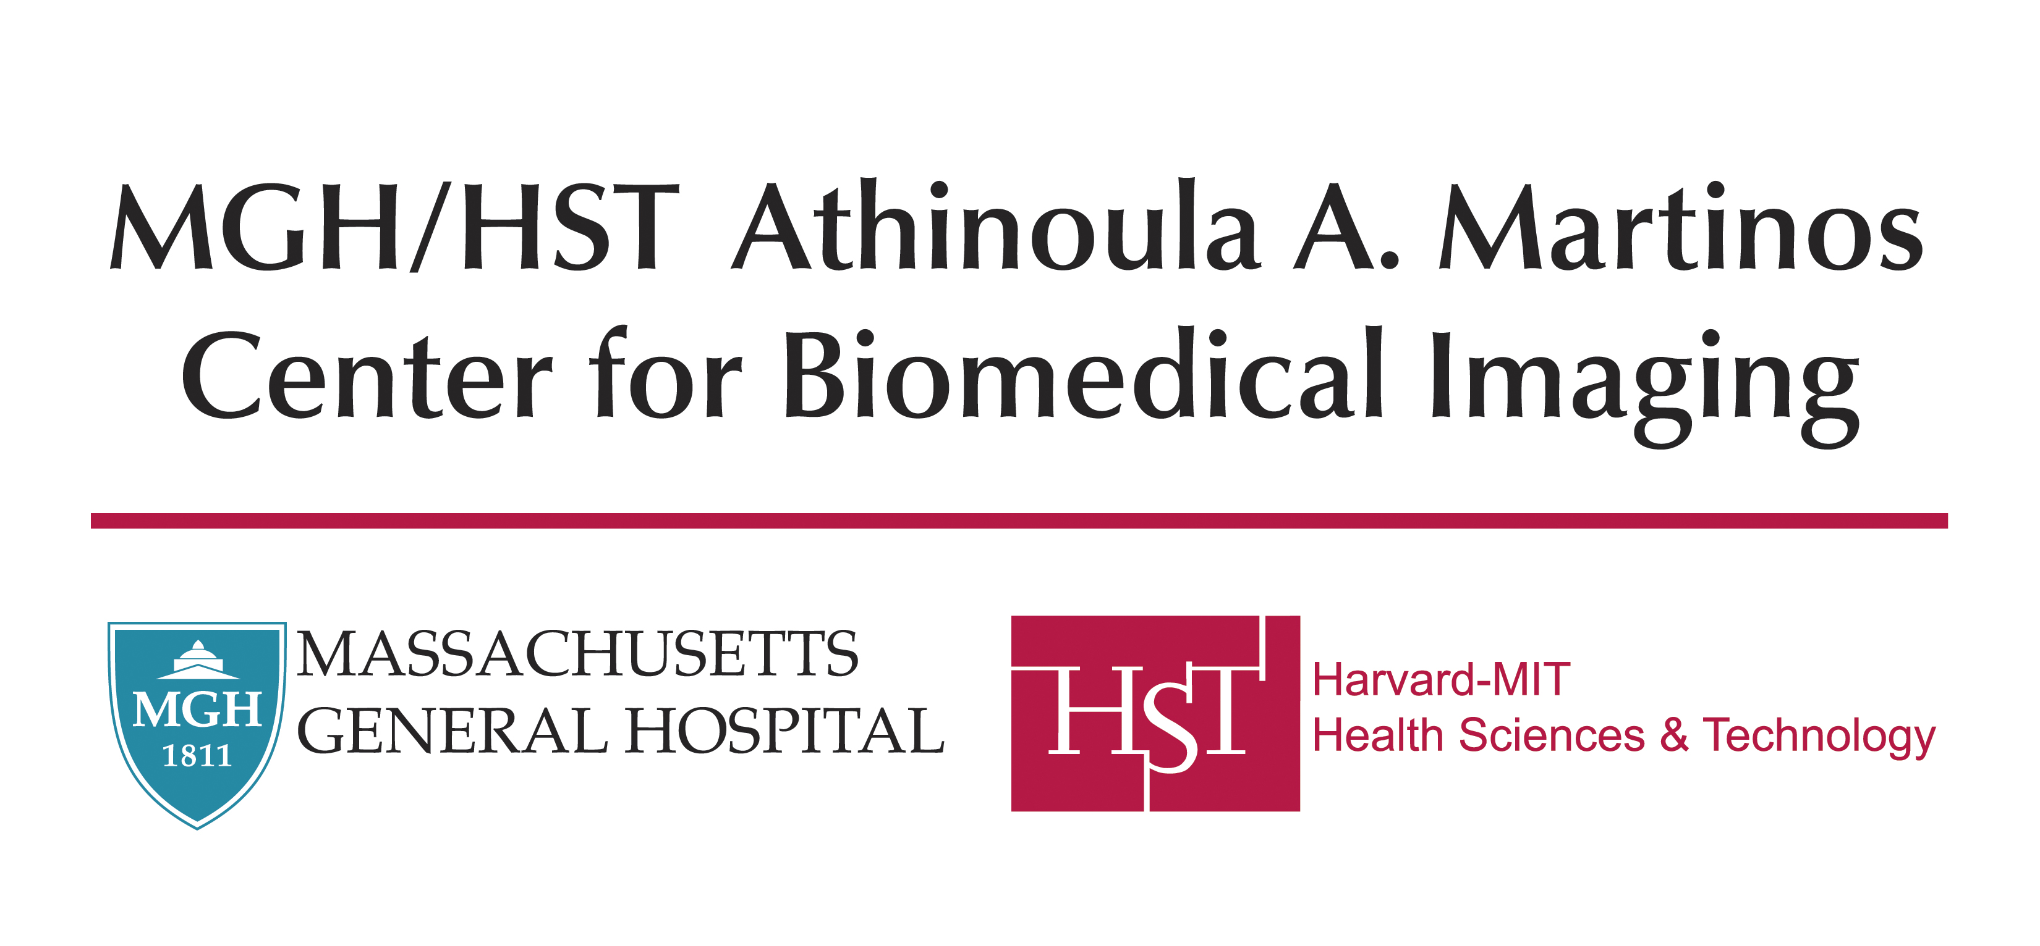
Postdoctoral Training
I joined the Martinos Center in August 2023.
Motivation: Tools for adults often struggle in early childhood and pre-natal periods.
Focus: My work focuses on fetal brain extraction and segmentation.

Slide 17
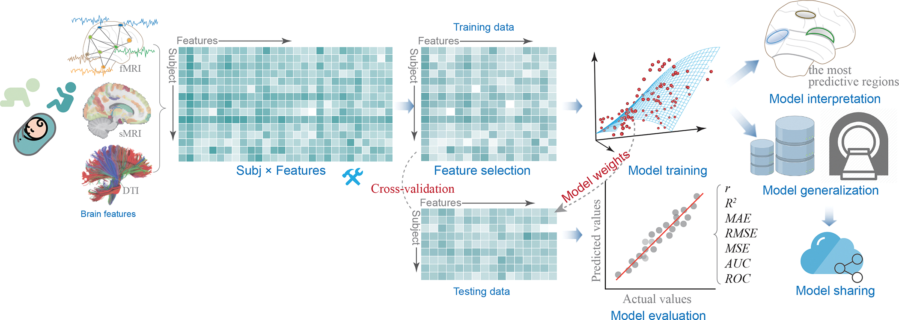
Motivation: Fetus, Infant, and Toddler Neuroimaging (FIT)
Predictive models aid risk stratification and support interventions
Most models focus on children of school age or older
Fetal, infant, and toddler (FIT) periods are critical for mental health.

Slide 18
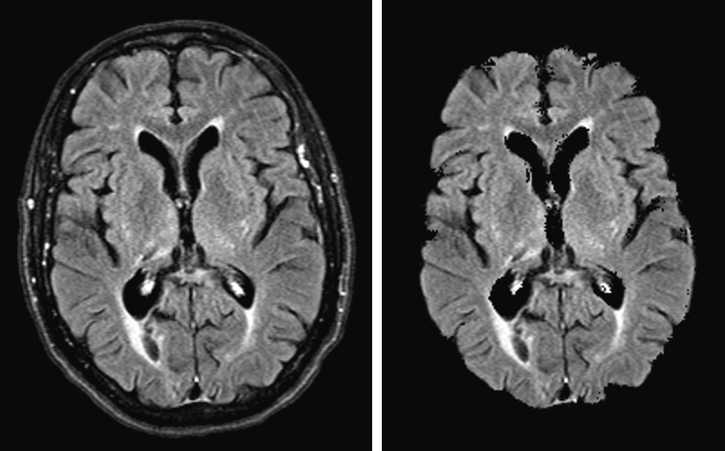
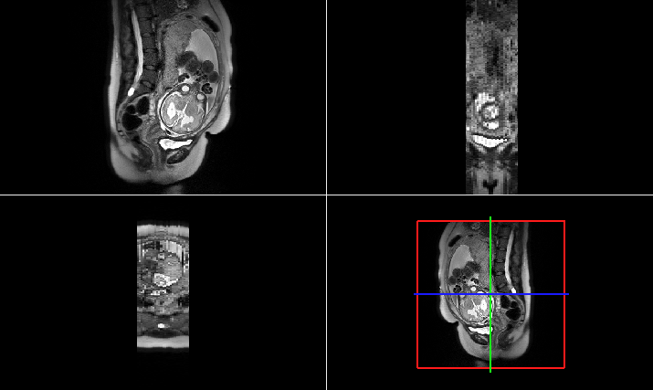
Skull Stripping and Brain Extraction Tools
Adult MRI
Fetal MRI
Hoopes, Andrew, et al. "SynthStrip: skull-stripping for any brain image." NeuroImage 260 (2022): 119474.

Slide 19
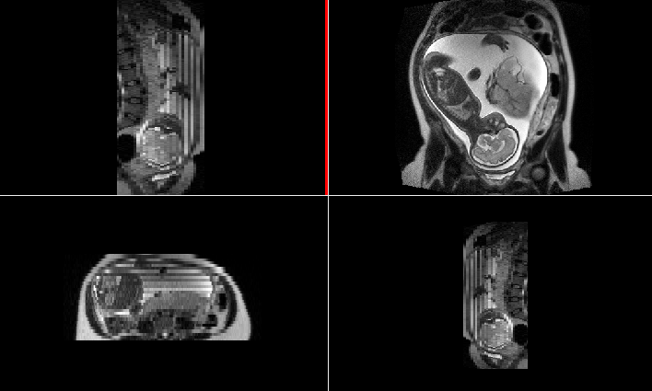
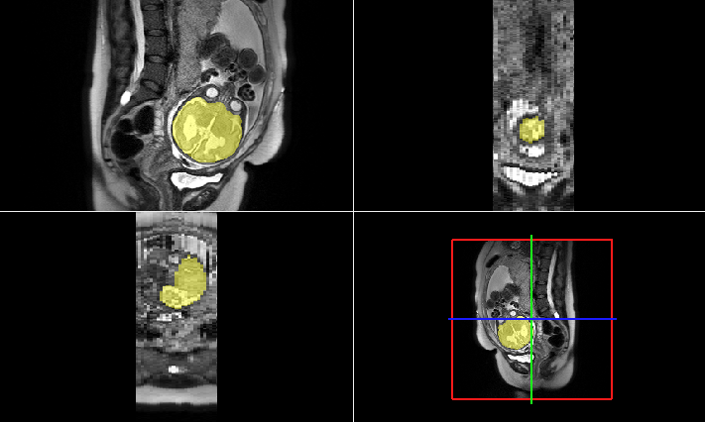
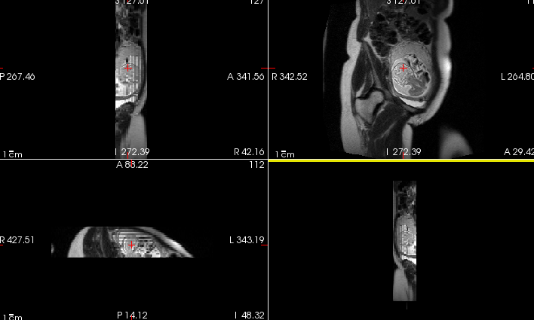
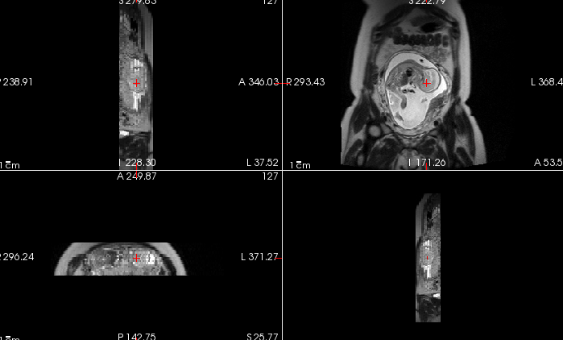
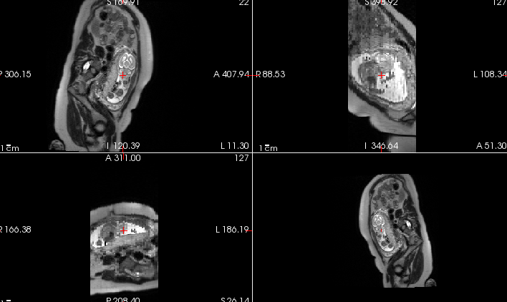
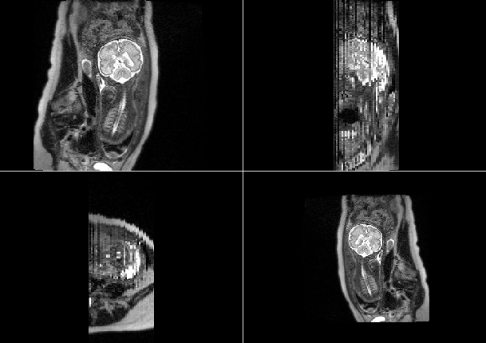
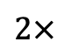
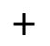
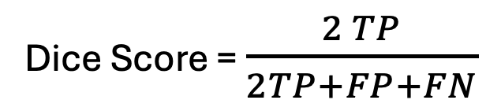
FIT Brain Detection/Extraction
Brains are different in size, shape, and orientation.
Brain masks are binary arrays
The dice coefficient is our main evaluation metric:
$$2×$$
Dice Score = $\frac{2 TP}{2TP+FP+FN}$
Dice Score =
Prediction
$$+$$
Ground Truth

Slide 20
Outline
Functional Connectomes
Tool 1: Data-driven Methods with Optimal Transport
Fetus, Infant, and Toddler (FIT) Neuroimaging
Tool 2: Automated Fetal Brain Extraction
Final Remarks

Slide 21
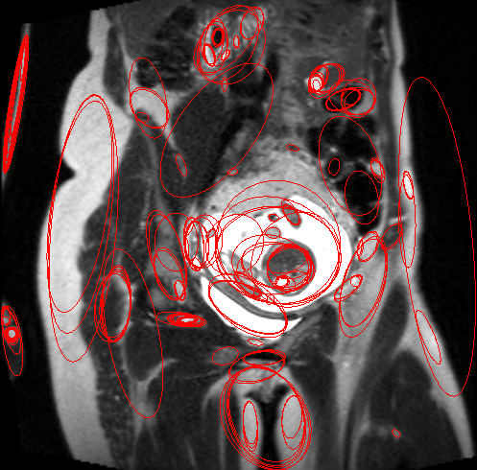
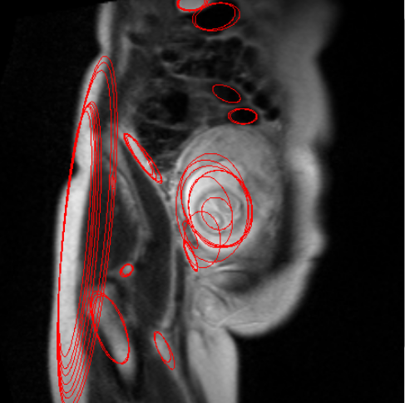
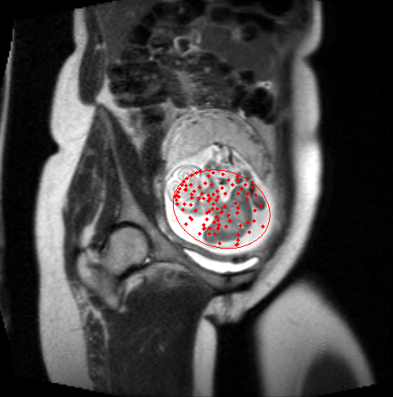
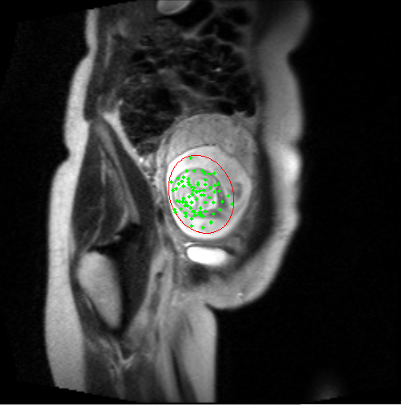
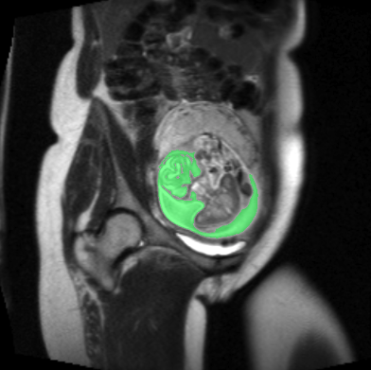
Automated Fetal Brain Extraction
1
2
Early methods were based on maximally stable features
Random forest (RF) and conditional random field (CRF) used for classification (Keraudren et al)
3
4
5

Slide 22

Convolutional Neural Network (CNN)
Convolution Layers: Detect spatial patterns in data (e.g., edges, textures).
Pooling: Reduces dimensionality, preserving essential features.
Filters/Kernels: Learn hierarchical features through small, learnable filters.
Applications: Widely used in image processing, medical imaging, and video analysis.

Slide 23
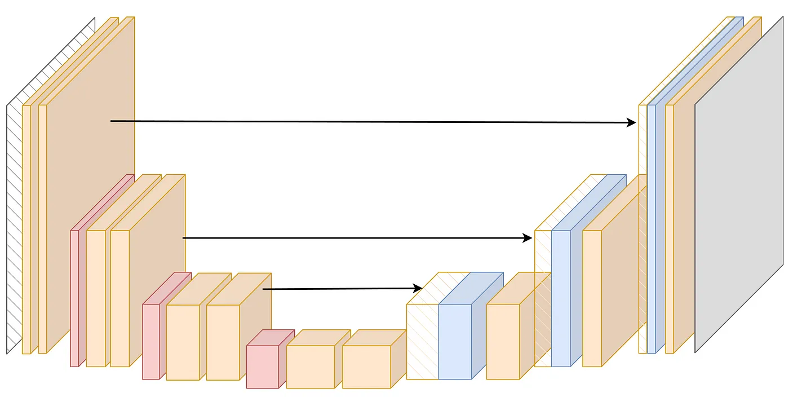
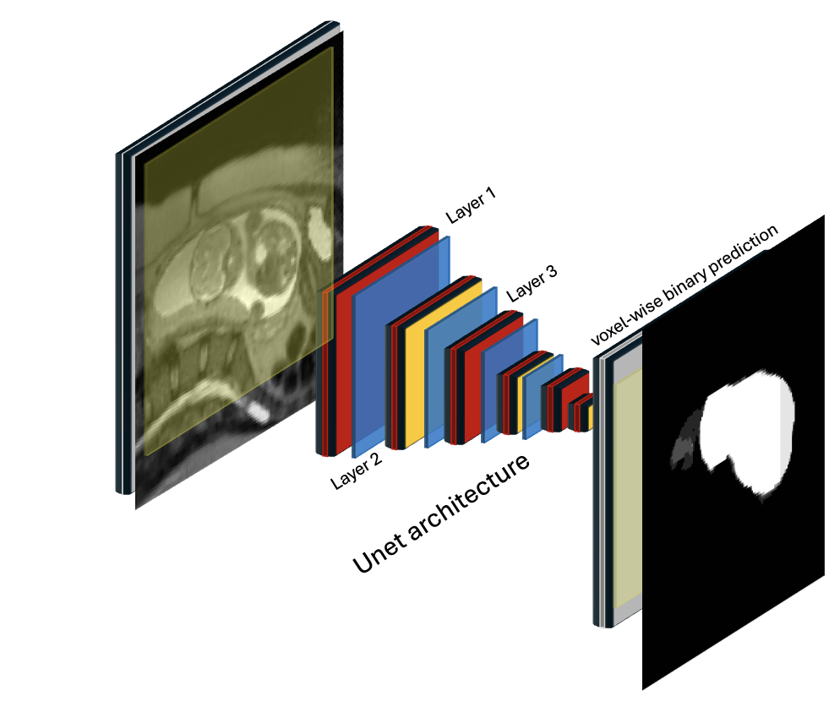
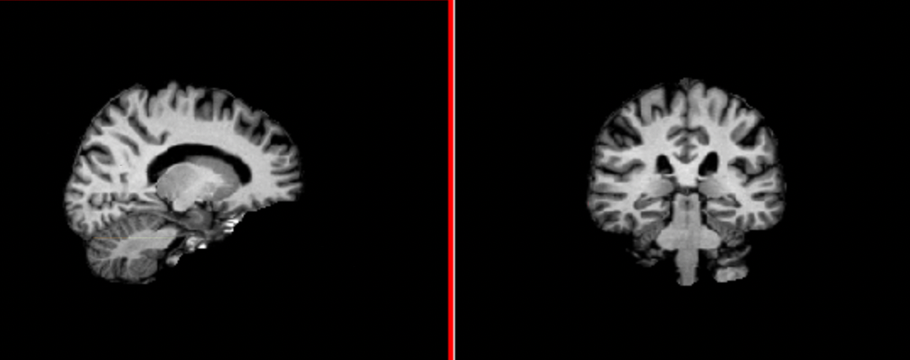
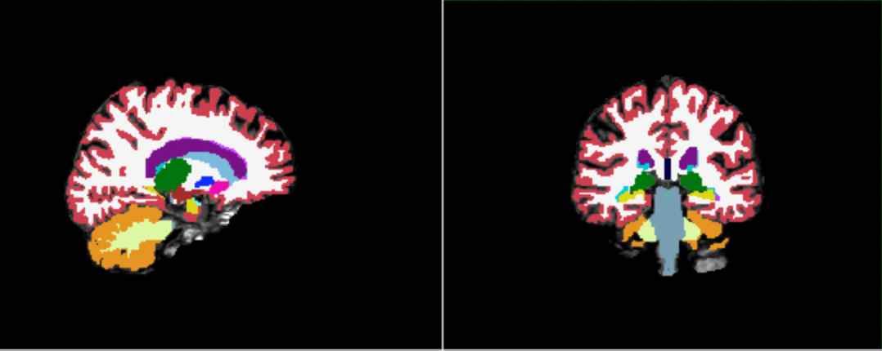
U-Net
Concatenate
Input Image
Deep learning (DL) models and U-Net are widely used for medical image analysis.
We can adapt U-Net for masking tasks effectively.
down sampling
up sampling
Layer 1
Layer 3
Output
Segmentation
Layer 2
U-Net architecture
Salehi, Seyed Sadegh Mohseni, et al. "Real-time automatic fetal brain extraction in fetal MRI by deep learning." ISBI, IEEE, 2018

Slide 24
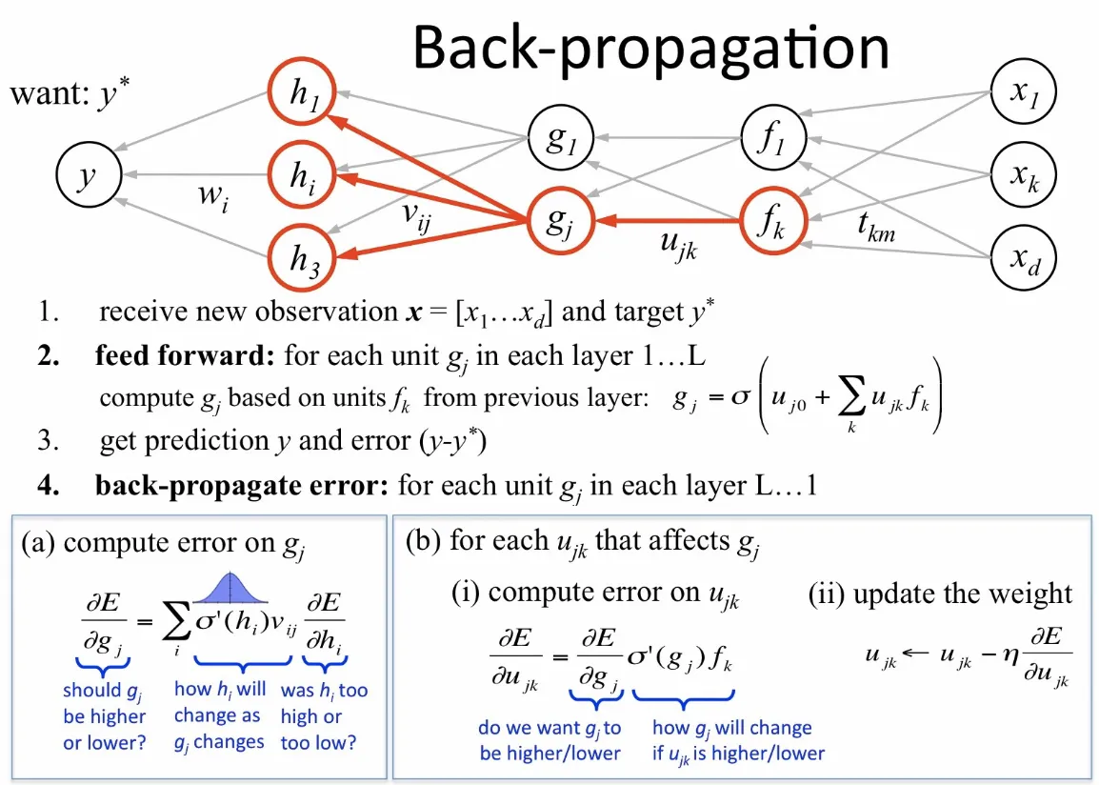
Back Propagation

Slide 25
Challenges with HASTE
In Plane
Half-Fourier acquisition single-shot turbo spin echo imaging (HASTE) and echo-planar Imaging (EPI) techniques are fast and popular
High contrast in the plane, low contrast through the plane
Through the Plane

Slide 26
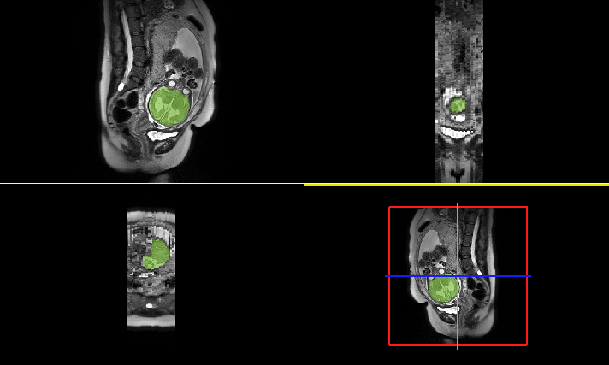
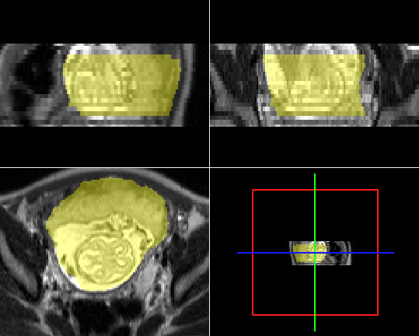
Challenges with 2D Models
35 Gestational Weeks (GW)
25 GW

Slide 27
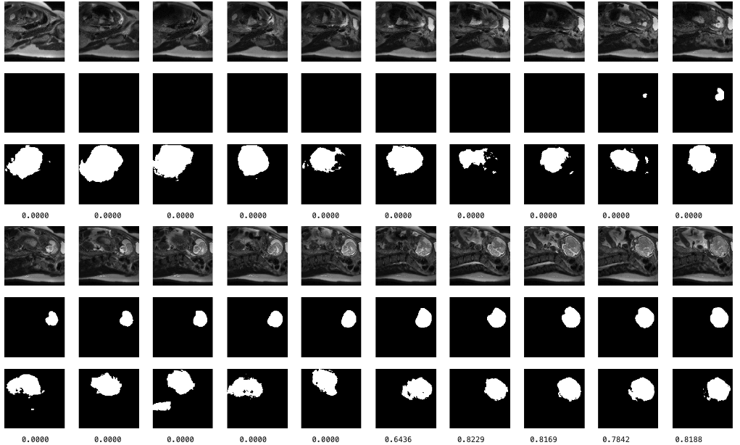
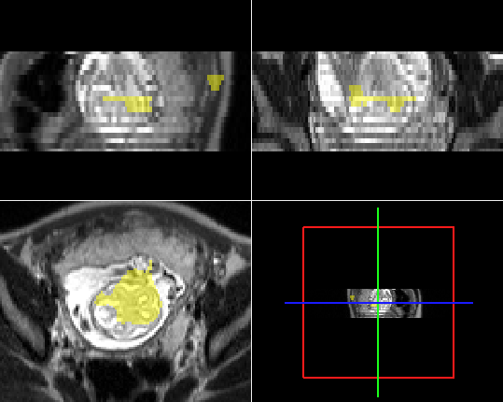
Automated Fetal Brain Extraction
2D Slices
3D Volume
Input Slice
Ground Truth
Prediction
Challenges: False positive tissues, missing slices, and lack of generalization to new contrast.
Input Slice
Ground Truth
Prediction

Slide 28
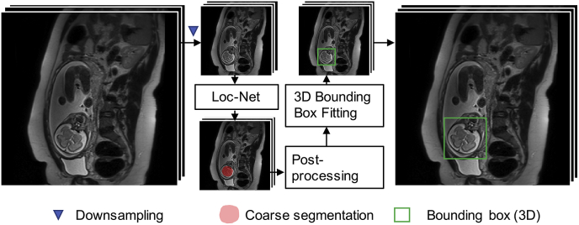
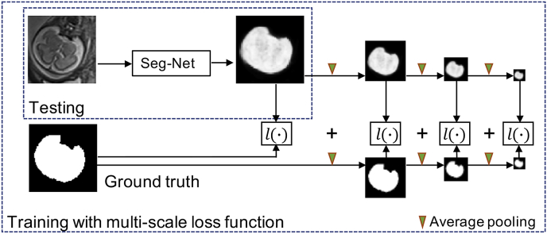
Two Step Solution
Localization
Two-step approach: Localize, then segment.
Reduce false positives before U-Net segmentation.
Segmentation
Ebner, Michael, et al. "An automated framework for localization, segmentation and super-resolution reconstruction of fetal brain MRI." NeuroImage (2020).

Slide 29
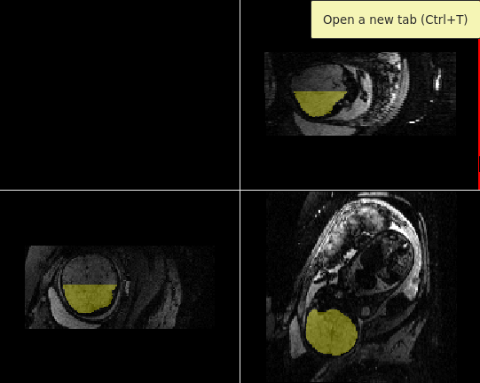
Generalization Problem
EPI Contrast
Trained on HASTE and tested on EPI contrast.
Lack of generalization.

Slide 30
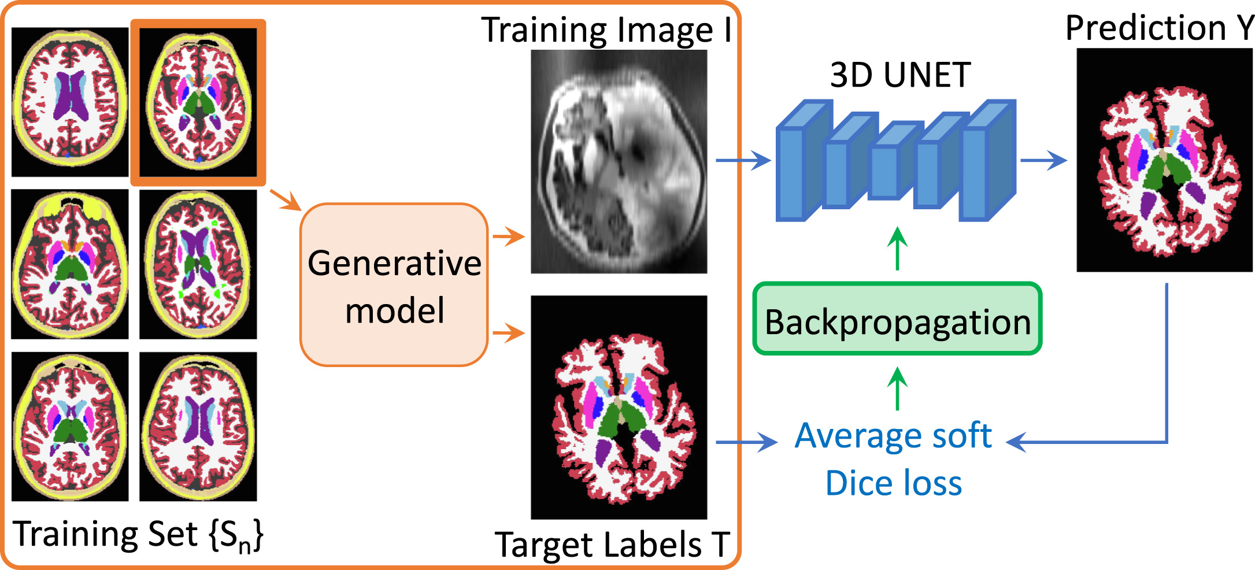
Synthetic Data
DL Models are Data-Hungry
Synthetic Data Enables
Data Augmentation
Overcoming Data Scarcity
Reducing Bias
Controlled Variability
Billot, Benjamin, et al. "SynthSeg: Segmentation of brain MRI scans of any contrast and resolution without retraining." Medical image analysis 86 (2023): 102789.

Slide 31
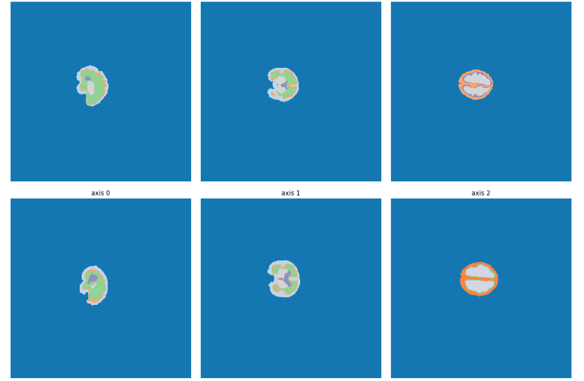
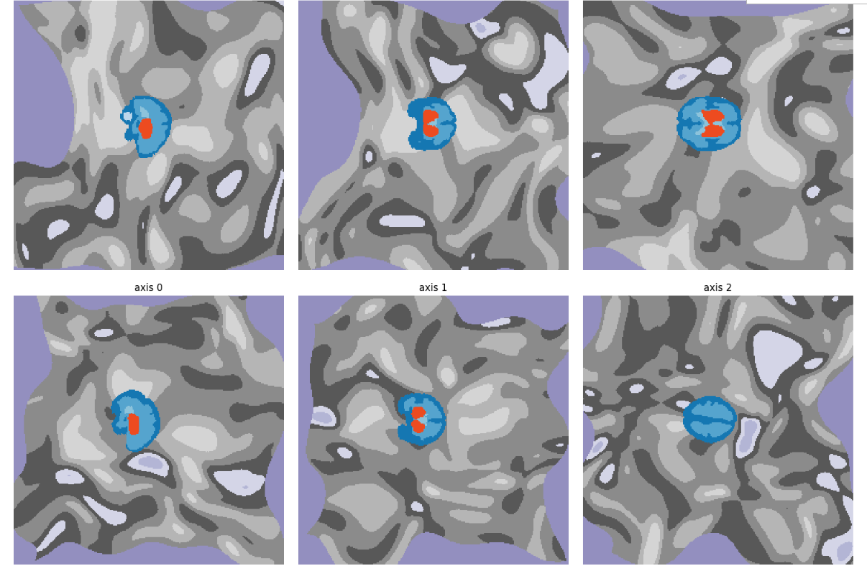
Synthetic Data for Fetal Images
Axis 0
Axis 1
Axis 2
40 Manually Labeled Fetal Brain Scans
Augmented with Random Shapes
Generate Unlimited Training Images
Label Maps

Slide 32
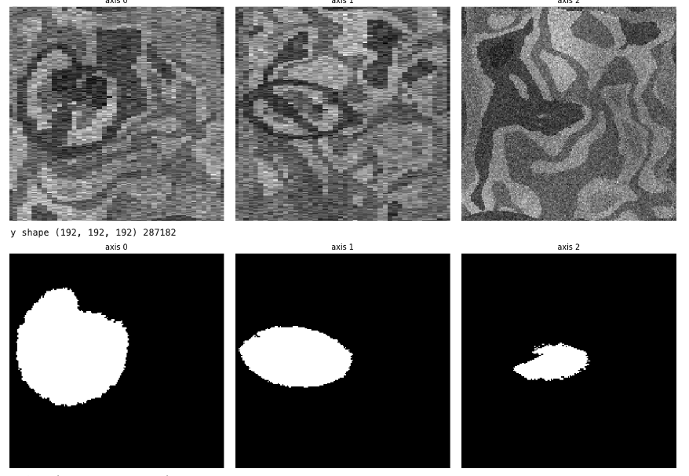
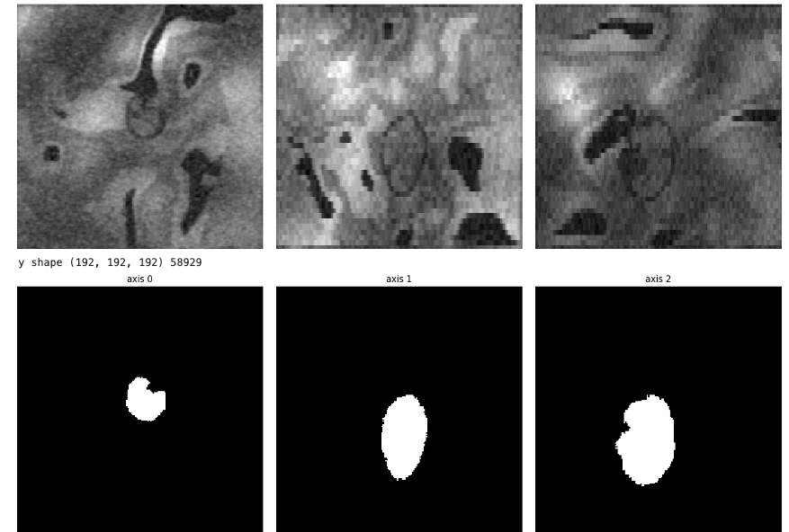


Examples of Synthetic Images
Axis 0
Axis 1
Axis 2
Axis 0
Axis 1
Axis 2
40 Manually Labeled Fetal Brain Scans
Augmented with Random Shapes
Generate Unlimited Training Images

Slide 33





High False Positive Rates
Axis 0
Axis 1
Axis 2
High False Positive Rates!
Don’t Generalize
Should We Try Different Backgrounds?

Slide 34




More Complex Backgrounds
Axis 0
Axis 1
Axis 2
Axis 0
Axis 1
Axis 2

Slide 35
Test-time Strategy
Reduce False Positives During Testing.

Slide 36

Sliding Windows
Classical sliding windows were used for detection tasks like face or abnormality detection.
A
A
Li, Haoxiang, et al. "A convolutional neural network cascade for face detection." Proceedings of the IEEE conference on computer vision and pattern recognition. 2015.

Slide 37


Sliding Windows
Li, Haoxiang, et al. "A convolutional neural network cascade for face detection." Proceedings of the IEEE conference on computer vision and pattern recognition. 2015.

Slide 38


Sliding Windows
Classical sliding windows were used for detection tasks like face or abnormality detection.
In our method, we apply voxel-wise segmentation.
This generates probability maps or weighted masks.
A
A
Weighted Mask

Slide 39

Tool 2: Breadth-First Search (BFS) and Deep Focused Sliding Windows (DFS)
Train four U-Nets for different window sizes
Include partial and absent brains in training data

Slide 40



Synthesis Ranges
We use 40 manually labeled fetal brain maps from FeTA 2021.
We select appropriate synthetic parameters for each model.
Model A
Model D

Slide 41


Tool 2: The Proposed BFS/DFS Framework
BFS identifies regions of interest (ROI)
DFS refines patches progressively
BFS
DFS
Input volume
Sub volume
A
D
B
C
A
D
Sliding window
3D volume
D
weighted mask

Slide 42

Results & Final Remarks

Slide 43


Results & Final Remarks
Loc-Net
BFS/DFS
192-Net

Slide 44
Outline
Functional Connectomes
Tool 1: Data-driven Methods with Optimal Transport
Fetus, Infant, and Toddler (FIT) Neuroimaging
Tool 2: Automated Fetal Brain Extraction
Final Remarks

Slide 45
Final Remarks
Key Contributions:
Privacy-Preserving Data Sharing: Accelerated connectomics research through data-driven methods with optimal transport.
Feature Extraction for FIT Neuroimaging: Developed a state-of-the-art fetal brain extraction tool using synthetic data.

Slide 46









Final Remarks
Future Directions:
Address the age effect in imaging analysis.
Expand testing to additional imaging modalities.
Incorporate motion artifacts into synthetic image generation.
Acknowledgments: Heartfelt thanks to the collaborators and institutions for their invaluable support:
Collaborators: Dustin Scheinost, Amin Karbasi, Xenophon Papademetris, Stephanie Noble, Todd Constable, Bruce Fischl, Lilla Zollie, Camilo Jaimes, Malte Hoffmann.
Institutions: Special thanks to the Broad Institute for hosting this talk.

Slide 47


Thank You!
Let me know if you have any questions.
https://dadashkarimi.github.io

